Slide 1

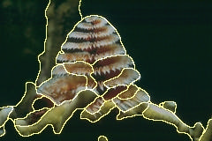
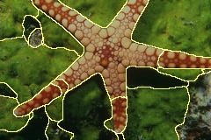
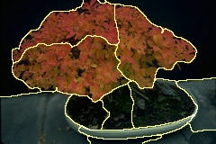
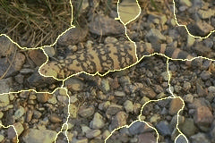
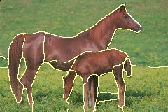
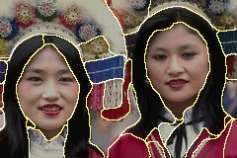
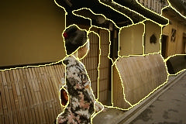
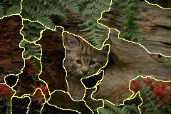
Image Segmentation
Class 4: Computational Vision
Class 4: Segmentation
Forsyth & Ponce: Computer Vision: A modern approach, Prentice Hall, 2002, Chapter 15

Slide 2

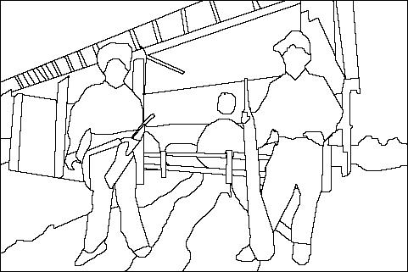
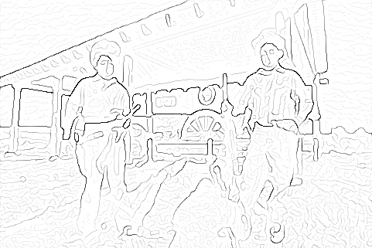
Last lecture
Various kernels for edge extraction
Sobel
Prewitt
Derivative of Gaussian
Laplacian of Gaussian
Canny edges – candidates for the best edge extractors
Edges extraction vs. image segmentation
image
human segmentation
gradient magnitude

Slide 3
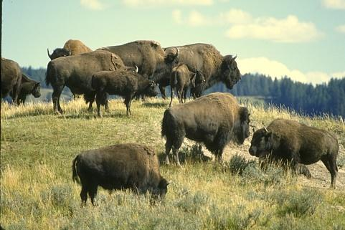
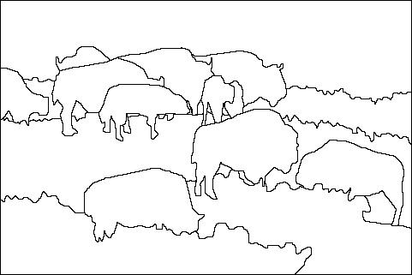
The goal of segmentation
Separate the image into coherent “objects”
How?
“Bottom-up” (from pixels to objects), or
“Top-down” process (from objects of interest to image pixels).
image
human segmentation
What is the difference between segmentation and edge detection?
Berkeley segmentation database: http://www.eecs.berkeley.edu/Research/Projects/CS/vision/grouping/segbench/

Slide 4
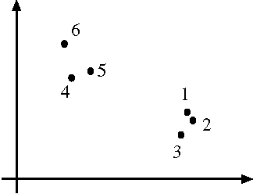
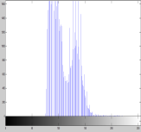
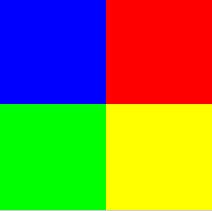
Segmentation and Grouping
Goal: Obtain a compact representation from an image or motion sequence
Broad theory is absent at present
Tokens
whatever we need to group (pixels, points, surface elements, etc., etc.)
Feature space: the space, where the tokens (e.g. pixels) are represented.
G
(0, 0, 255)
(255,0,0)
B
(0, 255,0)
R
(255,255,0)
Can this space assure that separate objects are segmented separately?

Slide 5
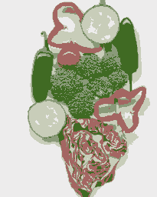
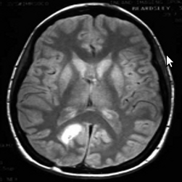
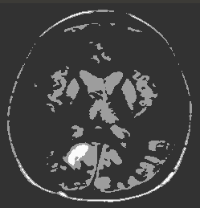
Clustering: what and why?
Segmentation
Separate the image into different regions
Summarizing data
Look at large amounts of data
Patch-based compression or denoising
Represent a large continuous vector with the cluster number
Use:
Object recognition
Compression
Clustering: group together similar points and represent them with a single token
Slide: Derek Hoiem

Slide 6
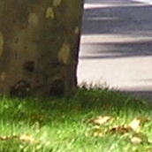
From edges to contours (index)
Segmentation & Gestalt principles
Segmentation
Background subtraction
Image pixels clustering
Agglomerative clustering
K-means
Mean-shift

Slide 7
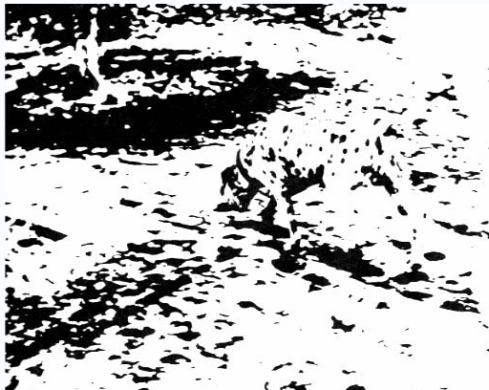
Perceptual organization
“…the processes by which the bits and pieces of visual information that are available in the retinal image are structured into the larger units of perceived objects and their interrelations”
Stephen E. Palmer, Vision Science, 1999
http://en.wikipedia.org/wiki/Gestalt_psychology

Slide 8
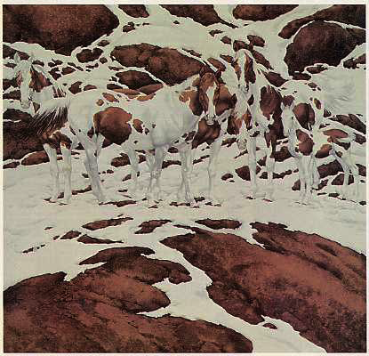
Human vision: Grouping and Gestalt
The Gestalt school of psychologists considers grouping as an important part of understanding human vision.
A common experience of segmentation is the way that an image can resolve itself into a figure — typically, the significant, important object — and a ground — the background on which the figure lies.
How: Their work was characterized by attempts to write down a series of rules by which image elements would be associated together and interpreted as a group.
Notes:
A disturbing possibility is that they all lie on a sphere -- but then, if we didn’t know that the tokens belonged together,
where did the sphere come from?

Slide 9

Basic ideas of grouping in humans
Figure-ground discrimination:
grouping can be seen in terms of allocating some elements to a figure, some to ground
impoverished theory.
Gestalt properties
A series of factors affect whether elements should be grouped together
Gestalt factors
Elements in a collection of elements can have properties that result from relationships (Muller-Lyer effect)

Slide 10
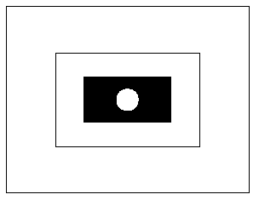
Human vision: Grouping and Gestalt
Segmentation is not just to think about pictures in terms of separating figure and ground (e.g. foreground and background).
This is (partially) because there are too many different possibilities in pictures like this one.
Is a square with a hole in it the figure? Or white circle on a black box?
Notes:
A driving force behind the gestalt movement is the observation that it isn’t enough to think about pictures in terms of separating figure and ground (e.g. foreground and background). This is (partially) because there are too many different
possibilities in pictures like this one. Is a square with a hole in it the figure? or a white circle? or what?

Slide 11
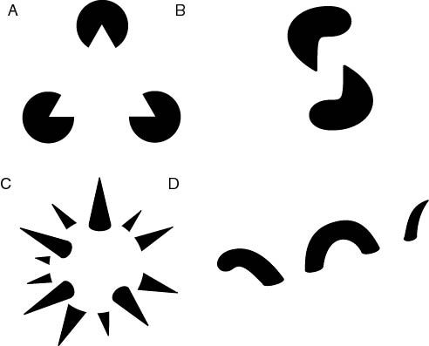
The Gestalt school
“The whole is greater than the sum of its parts”
subjective contours
occlusion
familiar configuration
http://en.wikipedia.org/wiki/Gestalt_psychology

Slide 12
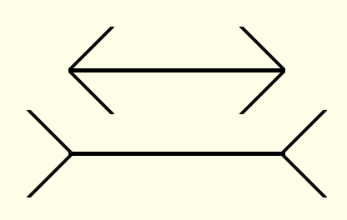
Inspiration from psychology
The Gestalt school: Grouping is key to visual perception
The Muller-Lyer illusion
http://en.wikipedia.org/wiki/Gestalt_psychology

Slide 13
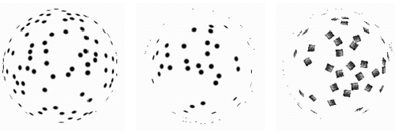
Human vision: Grouping and Gestalt
Why do these tokens belong together?
A possibility is that they all lie on a sphere -- but then, if we didn’t know that the tokens belonged together, where did the sphere come from?
Notes:
A disturbing possibility is that they all lie on a sphere -- but then, if we didn’t know that the tokens belonged together,
where did the sphere come from?

Slide 14
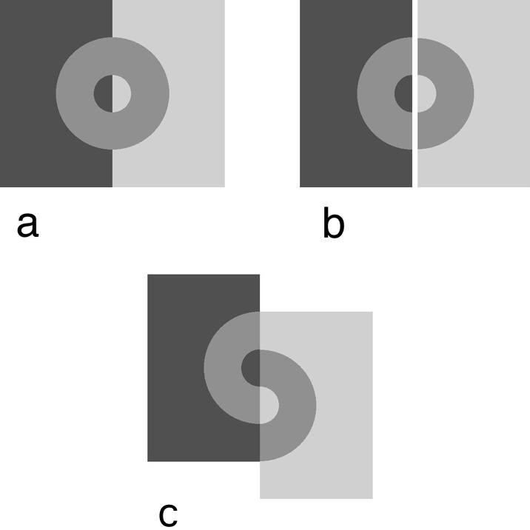
Influences of grouping
Grouping influences other perceptual mechanisms such as lightness perception
http://web.mit.edu/persci/people/adelson/publications/gazzan.dir/koffka.html

Slide 15
Gestalt factors
These factors make intuitive sense, but are very difficult to translate into algorithms

Slide 16


Familiarity

Slide 17
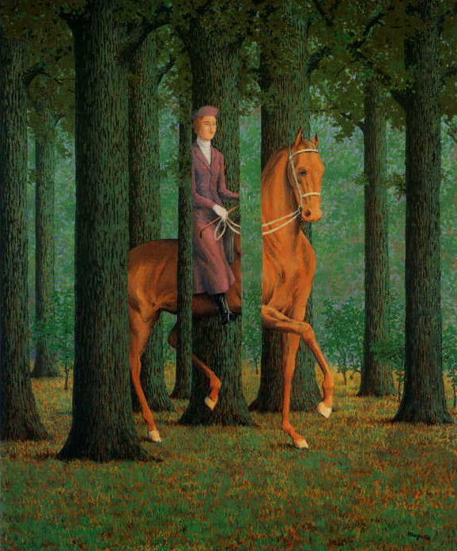
Occlusions
Magritte, 1957

Slide 18
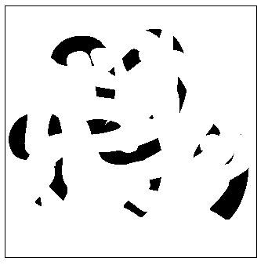
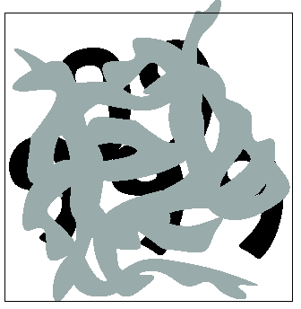
Occlusions and segmentation: Segmentation is a global process
What are the occluded numbers?
Occlusion cues seem to be very important in grouping.
This tendency to prefer interpretations that are explained by occlusion leads to interesting effects.
Notes:
Occlusion cues seem to be very important in grouping. Most people find it hard to read the 5 numerals in
this picture

Slide 19
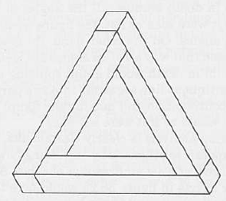
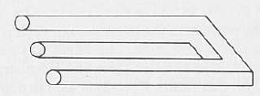
… but not too global
From Gestalt, there are some interesting top-down segmentation techniques.
In this course, we will work mainly with bottom-up segmentation techniques.

Slide 20
From edges to contours (index)
Segmentation & Gestalt principles
Automatic segmentation
Background subtraction
Image pixels clustering
Agglomerative clustering
K-means
Mean-shift

Slide 21
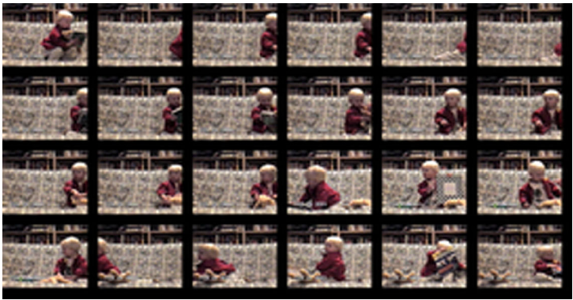
Technique: Background Subtraction
If we know what the background looks like, it is easy to identify “interesting bits”
Applications
Person in an office
Tracking cars on a road
Surveillance, etc.

Slide 22
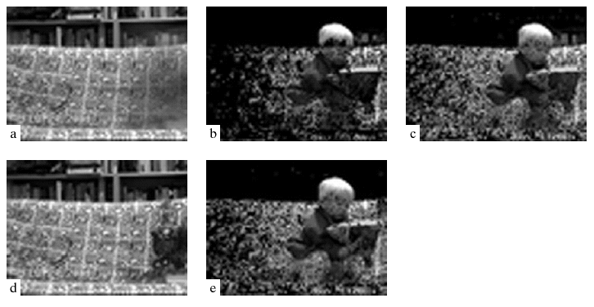
Technique: Background Subtraction
Approach:
Apply a median filter along the temporal axis to estimate the background image (BI)
Subtract BI from the current frame
Large absolute values are interesting pixels
Pros:
Simple and fast
Cons:
Needs many images
Needs static background
Noisy segmentation
Background image
Foreground object
Notes:
An important point here is that background subtraction works quite badly in the presence of high spatial frequencies, because when we
Estimate the background, we’re almost always going to smooth it.

Slide 23
From edges to contours (index)
Human grouping & Gestalt principles
Segmentation
Background subtraction
Image pixels clustering (bottom-up segmentation)
Agglomerative clustering or partition
K-means
Mean-shift

Slide 24
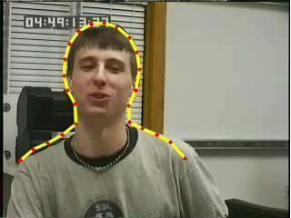
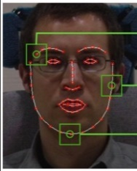
Grouping vs. fitting
Fitting: Top down segmentation
tokens belong together because they lie on the same object
Issues
which model?
which token goes to which element?
how many elements in the model?
Grouping/Clustering: Bottom up segmentation
tokens belong together because they are locally coherent
These two are not mutually exclusive!
Exercise: Given the images, in which image which approach is more suitable?

Slide 25
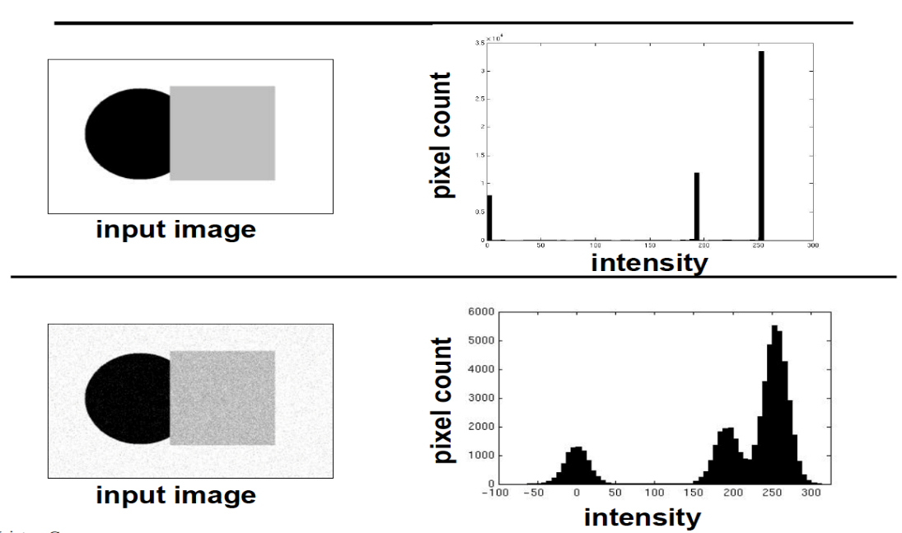
Clustering
Key Challenges:
1) What does make two points/images/patches similar?
2) How do we compute an overall grouping from pairwise similarities?
Slide: Derek Hoiem

Slide 26
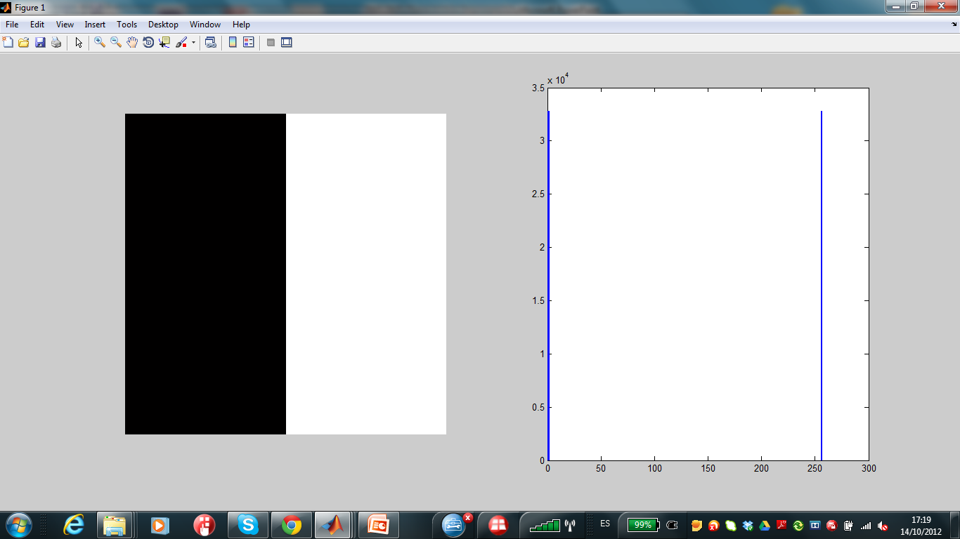
Issues
How do we decide that two pixels are likely to belong to the same object?
How many regions are there?
Is the histogram enough to separate image objects?

Slide 27
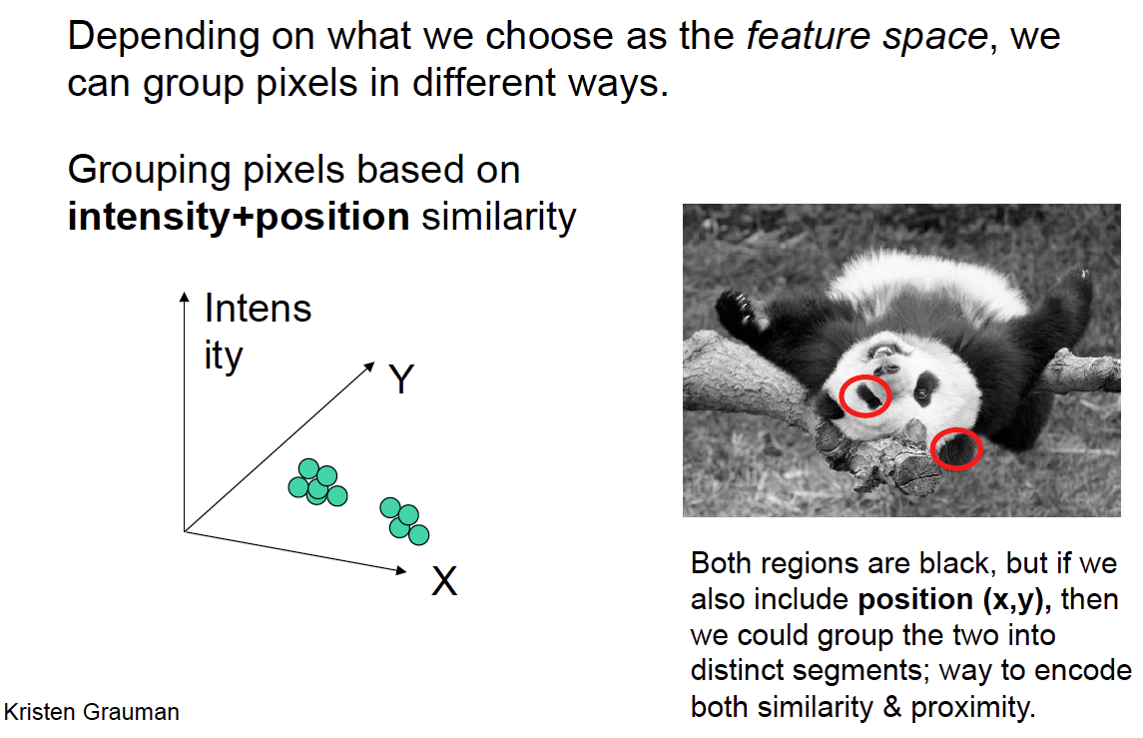
Feature space for clustering

Slide 28
Feature space for clustering: including spatial relationships
Augment data to be clustered with spatial coordinates.
Exercise: Draw the feature space for clustering in
Feature space is the grey level space
Feature space is the grey level space and spatial coordinates
Intensity coordinates
Spatial coordinates

Slide 29
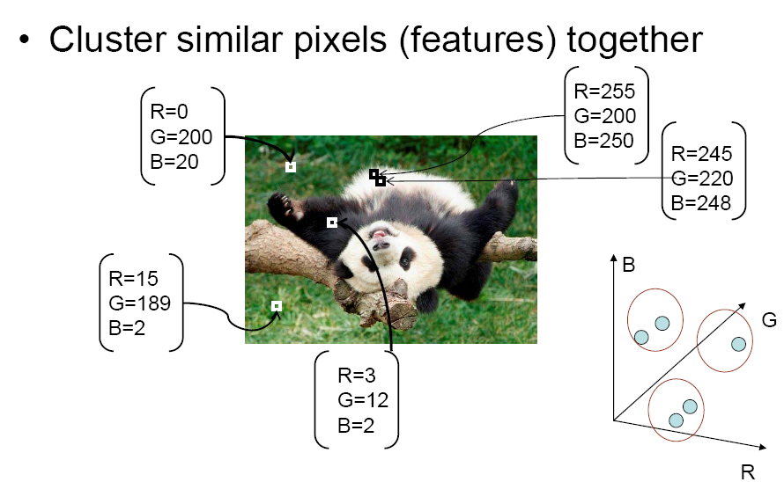
Feature space for clustering
Source: K. Grauman

Slide 30
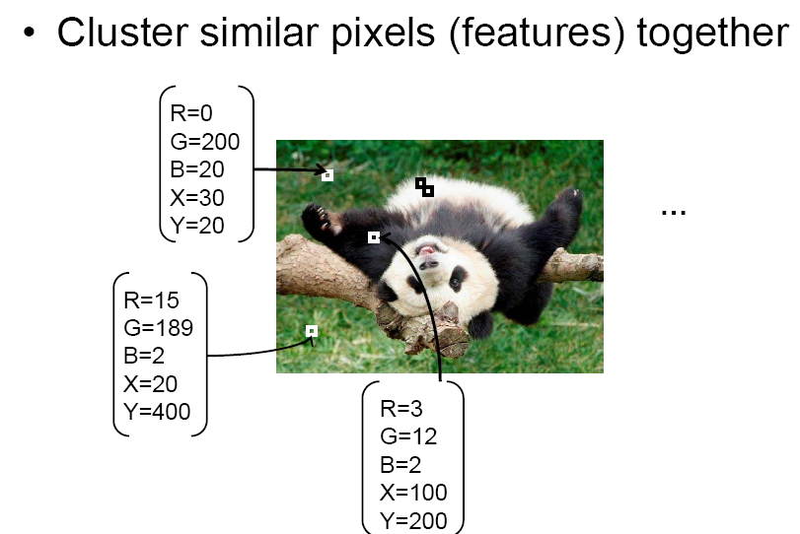
Feature space for clustering
Source: K. Grauman

Slide 31
A simple segmentation algorithm
Each pixel of the image is described by a vector in the feature space:
z = (R,G,B,X,Y), …
Run a clustering algorithm using some distance between pixels (e.g. Euclidean distance):
D(pixel _{i}, pixel _{j}) = || z_{i} – z_{j} ||²
G
(0, 0, 255)
(255,0,0)
R
B
(0, 255,0)
(255,255,0)
y
x

Slide 32
Bottom-up segmentation
Partitioning:
to decompose the large set of tokens into pieces that are “good” according to our model:
decompose an image into regions which have coherent colour and texture inside them;
Grouping:
to collect sets of data items that “make sense” together according to our model:
collecting together tokens that, taken together, form an object of interest.

Slide 33
How do we cluster?
We will see 3 main approaches:
Agglomerative clustering
Start with each point as its own cluster and iteratively merge the closest two clusters until some criteria of stopping merging.
K-means
Iteratively re-assign points to the nearest cluster center
Mean-shift clustering
Estimate modes of pdf

Slide 34
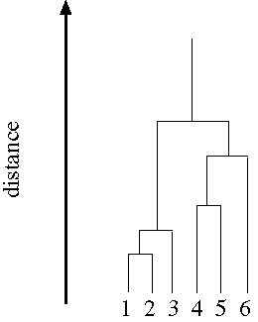
Agglomerative clustering
Cluster together (pixels, tokens, etc.) that belong together.
Agglomerative clustering
Attach the pixel closest to a cluster it is closest to
Repeat until…
Dendrograms
Yield a picture of output as clustering process continues
Divisive clustering
Split cluster along best boundary
Repeat until…
G
B
R
The final clusters represent the segmented objects.

Slide 35
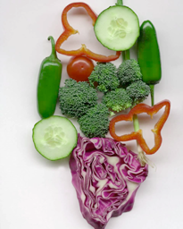
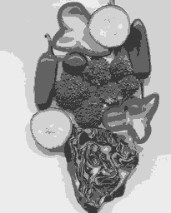
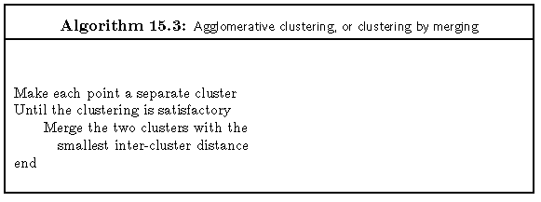
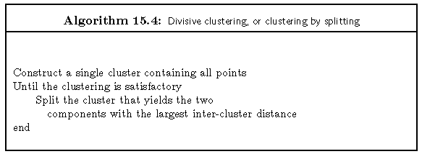
Agglomerative clustering
Pros:
Simple
Cons:
When to stop?
How to calculate the distance between points?
No information about pixels distribution

Slide 36
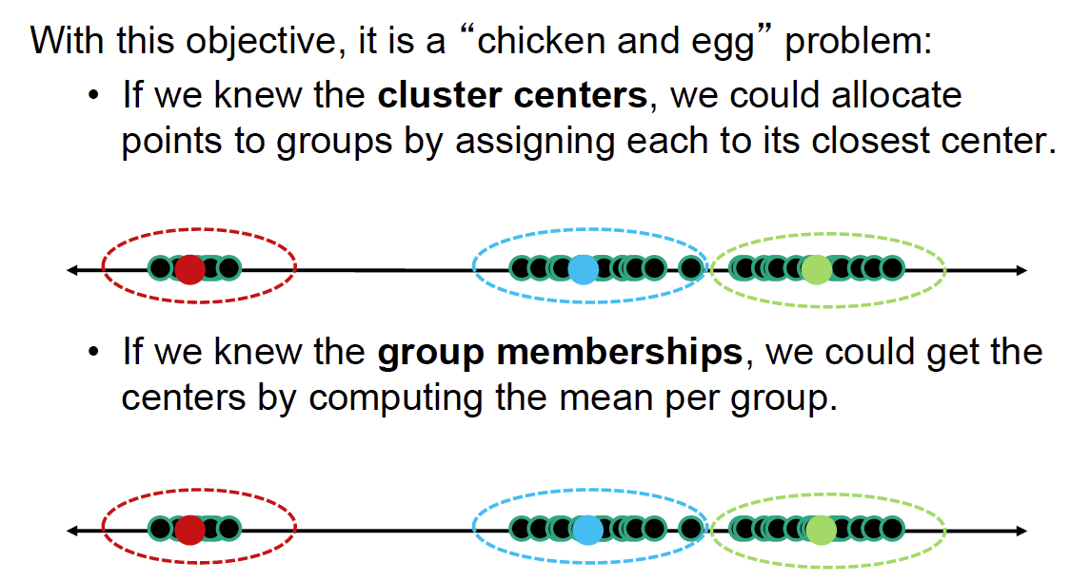
K-means clustering
Assume we look for k objects:
Gray level
Gray level

Slide 37
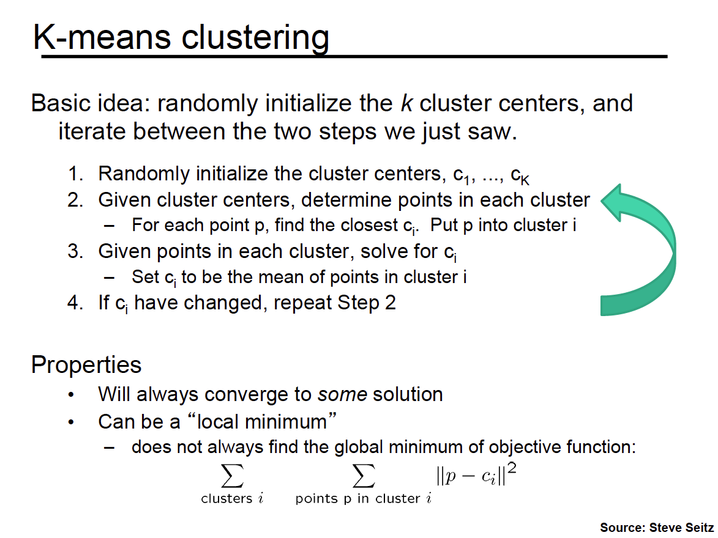
K-means clustering

Slide 38
K-means clustering
K-means clustering based on intensity or color
Clusters don’t have to be spatially coherent
Image
Intensity-based clusters
Color-based clusters
Notes:
I gave each pixel the mean intensity or mean color of its cluster --- this is basically just vector quantizing the image intensities/colors. Notice that there is no requirement that clusters be spatially localized and they’re not.

Slide 39
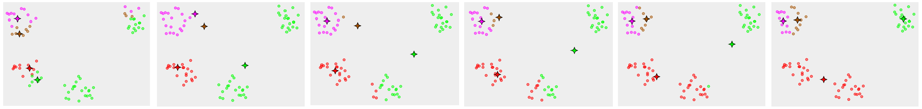
K-means: design choices
Initialization
Randomly select K points as initial cluster center
Distance measures
Traditionally Euclidean used, could be others
D((x1,y1),(x2,y2))=sqrt((x1-x2)^2+(y1-y2)^2)
Optimization
Will converge to a local minimum
May want to perform multiple restarts

Slide 40
K-means converges to a local minimum
Initial seeds position
Final seeds position and segmentation

Slide 41

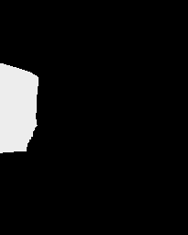



Segmentation as clustering
Clustering based on (R,G,B,X,Y) values enforces more spatial coherence
Notes:
I gave each pixel the mean intensity or mean color of its cluster --- this is basically just vector quantizing the image intensities/colors. Notice that there is no requirement that clusters be spatially localized and they’re not.

Slide 42
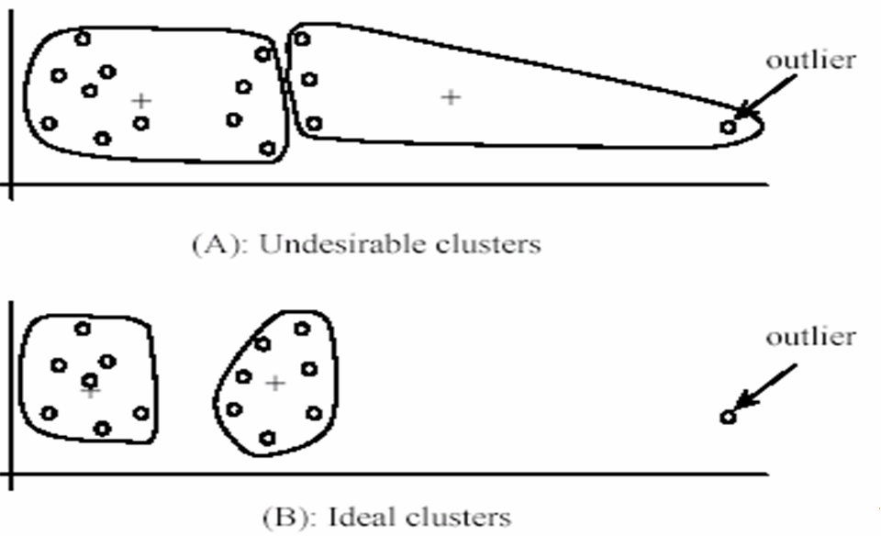
K-Means for segmentation
Pros
Very simple method
Converges to a local minimum of the error function
Cons
Memory-intensive
Need to pick K (number of seeds)
Sensitive to initialization
Sensitive to outliers
Only finds “spherical” clusters

Slide 43

Mean shift segmentation
An advanced and versatile technique for clustering-based segmentation
http://www.caip.rutgers.edu/~comanici/MSPAMI/msPamiResults.html
D. Comaniciu and P. Meer, Mean Shift: A Robust Approach toward Feature Space Analysis, PAMI 2002.

Slide 44

Mean shift algorithm
The mean shift algorithm is a generic algorithm that seeks the modes (most likely values of a pdf) or local maxima of density in the feature space
R
G
B
Image
Feature space (e.g. R,G,B color values)
The main difference between kmeans and mean shift is that mean-shift takes into account the distribution of the points in the feature space.

Slide 45


Finding modes in a histogram in 1D feature space
How many modes are there?
- easy to see, hard to compute.

Slide 46
Mean shift algorithm in 1D feature space
Window

Slide 47
Mean shift in 2D feature space
Search window
Center of
mass
Mean Shift
vector
Slide by Y. Ukrainitz & B. Sarel

Slide 48
Mean shift in 2D feature space
Search window
Center of
mass
Mean Shift
vector
Slide by Y. Ukrainitz & B. Sarel

Slide 49
Mean shift in 2D feature space
Search window
Center of
mass
Mean Shift
vector
Slide by Y. Ukrainitz & B. Sarel

Slide 50
Mean shift in 2D feature space
Search window
Center of
mass
Mean Shift
vector
Slide by Y. Ukrainitz & B. Sarel

Slide 51
Mean shift in 2D feature space
Search window
Center of
mass
Mean Shift
vector
Slide by Y. Ukrainitz & B. Sarel

Slide 52
Mean shift in 2D feature space
Search window
Center of
mass
Mean Shift
vector
Slide by Y. Ukrainitz & B. Sarel

Slide 53
Mean shift in 2D feature space
Search window
Center of
mass
Slide by Y. Ukrainitz & B. Sarel

Slide 54


Mean shift in 2D feature space
Density is proportional to the number of points in the window/kernel/badwidth
Cluster: all data points in the attraction basin of a mode
Attraction basin: the region for which all trajectories lead to the same mode
Density
Test:
a) The higher the bandwidth is, __________ number of clusters will be detected.
b) The higher the window is, ____________ the segmented image is.

Slide 55

Mean shift algorithm in 3D feature space
Window in image domain
Intensities of pixels within image domain window
2
1
0 1
3
Center of mass of pixels within both image and range domain windows
0 1
Window in intensity domain
4
Center of mass of pixels within both image and intensity domain windows
6
5
0 1
7
0 1
Apply mean shift jointly in the image (left col.) and intensity (right col.) domains

Slide 56

Mean shift algorithm
Comaniciu and Meer, IEEE PAMI vol. 24, no. 5, 2002

Slide 57

Mean shift clustering/segmentation
Find features (e.g. color, etc)
Initialize windows at individual feature points
Perform mean shift for each window until convergence
Merge windows that end up at the same “peak” or mode

Slide 58




Mean shift segmentation results
http://www.caip.rutgers.edu/~comanici/MSPAMI/msPamiResults.html

Slide 59

More results

Slide 60

Mean shift segmentation results

Slide 61


Mean shift pros and cons
Pros
Does not assume spherical clusters
Just a single parameter (window size i.e. the bandwidth)
Finds variable not prefixed number of modes
Robust to outliers
Generic technique
Find multiple modes
Cons
Output depends on window size (bandwidth size)
Computationally expensive
Shell we treat in the same way different features?

Slide 62

Challenge: understanding complex environments

Slide 63

Summary
Segmentation – an open problem, very active currently
Different methods exist: k-means, mean-shift, etc., but still too simple…
We need to segment highly dynamic and complex environments:
Segmentation is important, but without high-level knowledge is very difficult!
Last works combine: segmentation and object recognition.

